Slide 1
KUSD
Employee Survey Summary
KTEC West
KUSD Mission: Provide excellent, challenging learning opportunities and experiences that prepare each student for success.

Slide 2
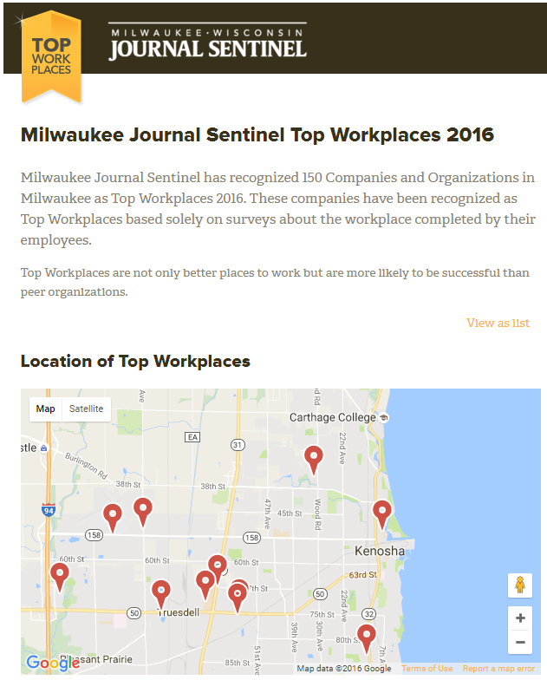

Survey Snapshot
Utilize Energage
  (formerly Workplace Dynamics)
  Industry recognized company
  Conducted HR related surveys to over 47,000 organizations & over 16 million individuals since 2006
Annual publication of top workplaces in the Milwaukee Journal Sentinel
Notes:
Closes early January, should know by mid-January if KUSD made the list. Reached #37 in 2016. More than 100 companies in SE Wisconsin with over 500 employees were asked to participate. 37 completed the process.

Slide 3
Survey Participation
 | 2015 | 2016 | 2017
Survey Window | April 13-27 | October 3-17 | October 2-16
Surveys Sent | 2,502 | 2,528 | 2,532
Responses | 2,098 | 2,084 | 1,880
Response Rate | 83.9% | 82.4% | 74.2%
Comments & Improvement Ideas | 4,200 | 3,800 | 5,361
Notes:
Energage benchmark is minimum 63% response rate.

Slide 4
Experience of Responders
 | 2015 | 2016 | 2017
More than 15 years | 32% | 36% | 38%
10 -15 years | 25% | 20% | 18%
5 -10 years | 17% | 14% | 13%
3 - 5 years | 12% | 9% | 12%
1 - 3 years | 7% | 11% | 12%
6 - 12 months | 5% | 1% | 1%
Less than 6 months | 1% | 7% | 5%
Once again, the majority of responders (56%) have more than 10 years of experience.
Notes:
Follows the experience break points of other staff surveys.

Slide 5
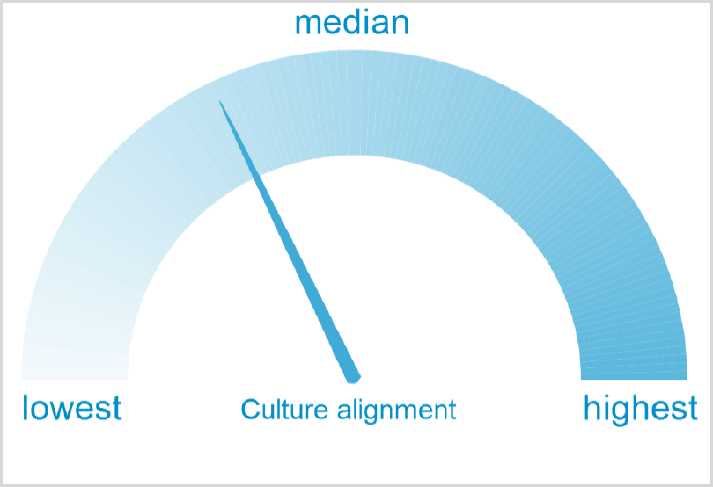
Working Culture Alignment
The working culture alignment score measures how much employees agree on the company’s culture. Do employees all have a clear and united idea of the work culture, or were they more scattered?
KUSD’s working culture alignment is typical. This graphic is unchanged from the previous survey.
Notes:
Core values and SD plans were approved in mid-2017 and should continue to receive broad sharing with all stakeholders.
5

Slide 6
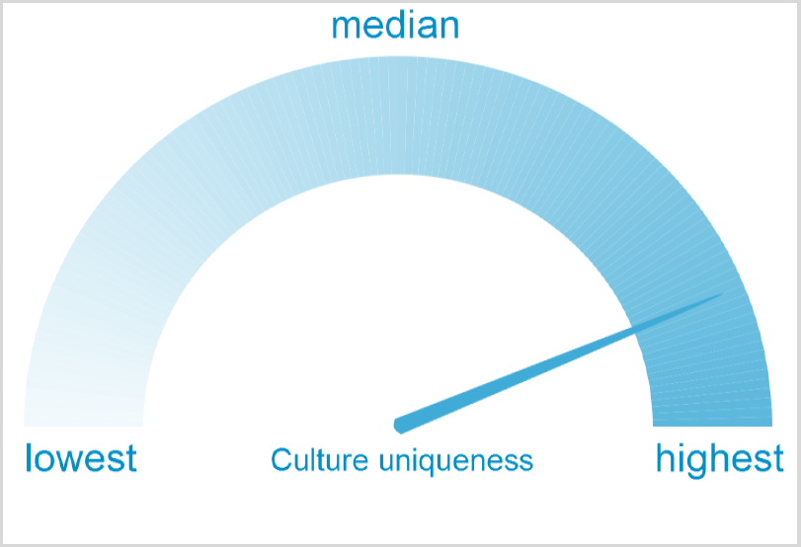
Working Culture Uniqueness
The working culture uniqueness score measures how much the work culture stands out when compared to similar companies. Is the work culture distinct and identifiable or is it more unfocused and generic?
KUSD’s work culture is more unique than average, with a consistent result when compared to last year.
Notes:
Not necessarily bad to have a high culture, just something to be aware of when trying to enact any form of change/growth.
6

Slide 7
Two Major Metrics
The Basics
“The Basics” measures aspects of the job that an employee generally knows before accepting:
This covers expectations, compensation, work/life balance, and opportunities for career development.
These are important to provide but are not areas that make people feel passionate about the organization.
OrgHealth
“OrgHealth” evaluates whether your company is likely to succeed in the long term:
This covers working with managers, having a clear sense of direction, executing brilliantly, innovating, and making employees feel valued.
Above everything else, employees want to work at companies with high levels of OrgHealth.

Slide 8










What The Survey Measures:
The Basics
OrgHealth
Drive
Business Outcomes
My Manager
Do they make work harder or easier?
My Work
Do I have the tools, colleagues and training to succeed?
Am I motivated to give my best?
Would I recommend working here to others?
Have I been looking for another job?
Alignment
Where are we headed?
My Pay & Benefits
Are they fair?
Effectiveness
Are we making progress?
How do we know if
we’re contributing?
My Expectations
Has the job meet or exceeded my expectations?
Connection
Do I see a future here?

Slide 9
Positive Engagement Regarding Business Outcomes
The overall engagement measures the percentage of responders who answered “Slightly Agree” or better to ALL THREE engagement statements.
34% of KUSD responders answered positively for all three engagement statements, previous surveys produced 31% for both 2015 and 2016.
OrgHealth and culture are directly impacted by employee engagement.
Business Outcomes
Am I motivated to give my best?
Have I been looking for another job?
Would I recommend working here to others?

Slide 10
Department Report
KTEC(WEST)
KUSD
Notes:
10

Slide 11
Introduction
OrgHealth™ measures your organization’s long term potential based on four themes:
  Organizational alignment
  Effective execution
  Genuine and meaningful connection
  with employees
  Management skills
Research shows that employees want to work at companies with great OrgHealth™ above all else
Alignment
Effectiveness
Connection
My Manager
Notes:
11

Slide 12
OrgHealth Theme Overview
Alignment
Effectiveness
There is good inter-departmental cooperation at KUSD
I believe KUSD is going in the right direction
KUSD operates by strong values and ethics
There is not a lot of negativity at my workplace
Senior managers understand what is really happening at KUSD
At KUSD, we do things efficiently and well
KUSD encourages different points of view
New ideas are encouraged at KUSD
Connection
My Manager
My job makes me feel like I am part of something meaningful
KUSD enables me to work at my full potential
I feel genuinely appreciated at KUSD
I feel well-informed about important decisions at KUSD
My manager cares about my concerns
My manager helps me learn and grow
My manager makes it easier to do my job well

Slide 13
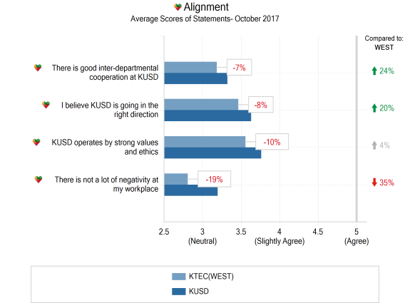
OrgHealth
Alignment
This chart shows KTEC(WEST)’s score for each statement (in light blue) compared to the average score for KUSD (in dark blue) and the far right column compares the KTEC(WEST)'s score for each statement to your previous survey.

Slide 14
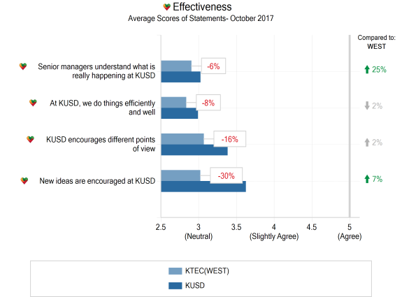
OrgHealth
Effectiveness
This chart shows KTEC(WEST)’s score for each statement (in light blue) compared to the average score for KUSD (in dark blue) and the far right column compares the KTEC(WEST)'s score for each statement to your previous survey.

Slide 15
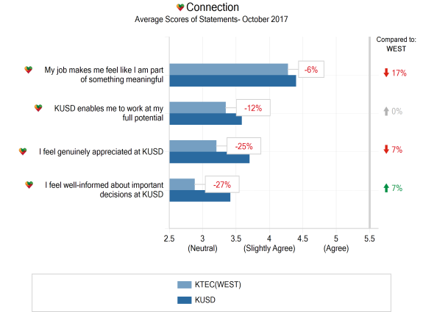
OrgHealth
Connection
This chart shows KTEC(WEST)’s score for each statement (in light blue) compared to the average score for KUSD (in dark blue) and the far right column compares the KTEC(WEST)'s score for each statement to your previous survey.

Slide 16
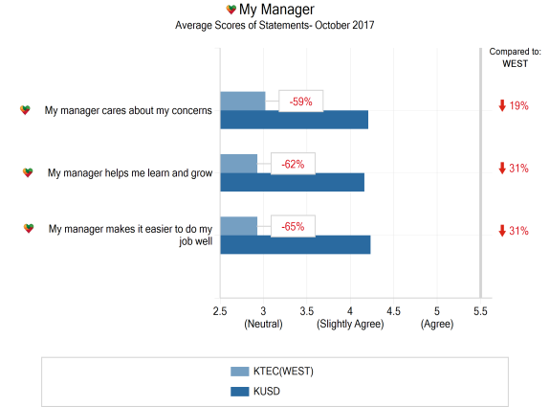
OrgHealth
My Manager
This chart shows KTEC(WEST)’s score for each statement (in light blue) compared to the average score for KUSD (in dark blue) and the far right column compares the KTEC(WEST)'s score for each statement to your previous survey.

Slide 17
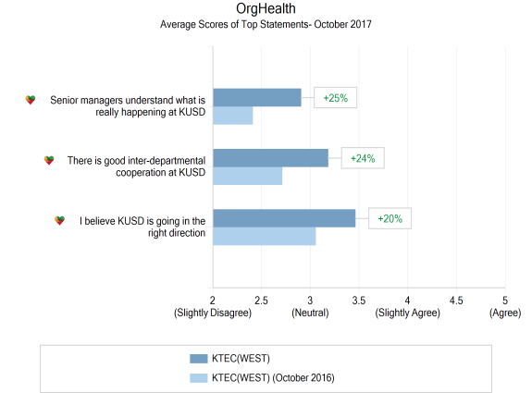
Most improved statements
This chart shows KTEC(WEST)’s survey statements that have improved the most (or declined the least).
The dark blue bars on this chart show KTEC(WEST)’s average score on each statement.
The light blue bars show KTEC(WEST)’s average score on each statement from your previous survey.

Slide 18
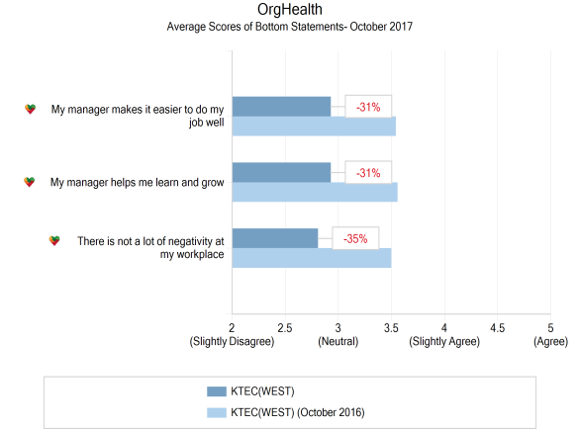
Least improved statements
This chart shows KTEC(WEST)’s survey statements that have improved the least (or declined the most).
The dark blue bars on this chart show KTEC(WEST)’s average score on each statement.
The light blue bars show KTEC(WEST)’s average score on each statement from your previous survey.

Slide 19

Results by demographic

Slide 20
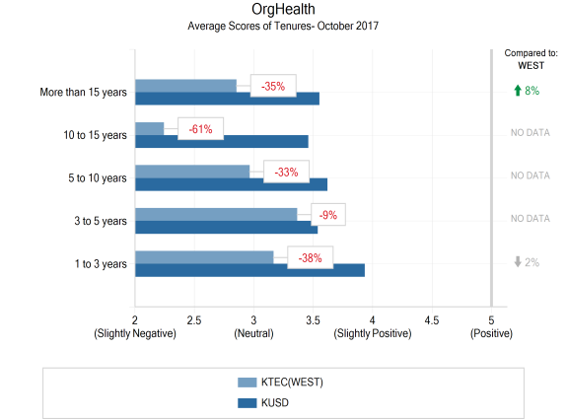
Tenure
This chart shows KTEC(WEST)’s score for each Tenure Band compared to KUSD's average for each Tenure Band and the far right column compares the KTEC(WEST)'s score for each Tenure band to your previous survey.
Tenure Bands with fewer than 5 responders are excluded.

Slide 21
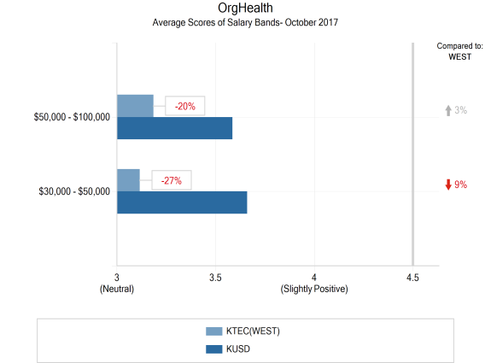
Salary band
This chart shows KTEC(WEST)’s score for each Salary Band compared to KUSD's average for each Salary Band and the far right column compares the KTEC(WEST)'s score for each Salary band to your previous survey.
Salary Bands with fewer than 5 responders are excluded.

Slide 22
WorkplaceDynamics

Slide 23
Top Focus Areas
Though overall responses were mainly steady or improving, there still exists the opportunity for growth.
Creating clear lines of communication to voice concerns and solve problems in a productive and timely manner.
Continuing to refine the educational programming that we offer and create clear, focused plans moving forward.
Work on reducing negativity in the workplace.

Slide 24
Top Celebrations
There are multiple areas to celebrate with the latest staff survey results.
Our staff feels the district is going in the right direction.
The implementation of a salary schedule, along with increased attention towards overall showcasing for good work produced positive change regarding staff appreciation.
Results show that everyone still enjoys what they do.

Slide 25
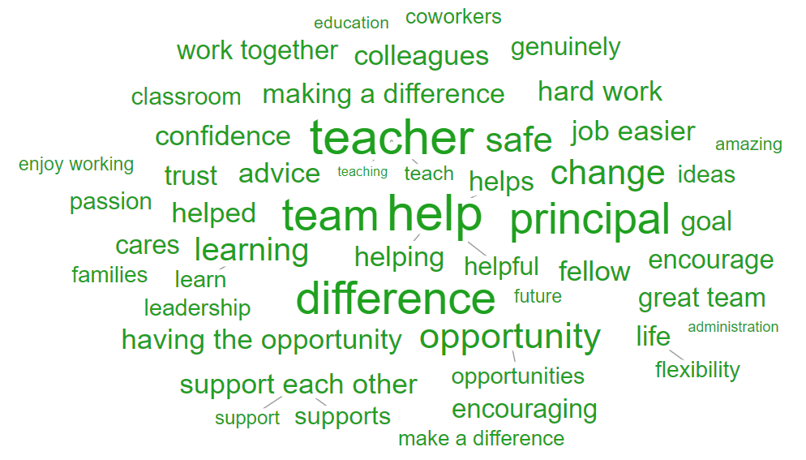
I My Job Because…
Notes:
Every word above was used more often in your organization than in your benchmark. The larger words appeared the most, while the smaller words did not stand out as significantly.

